Slide 1
NE 763: Advanced Reactor Materials
Fall 2026
Dr. Benjamin Beeler

Slide 2
Today
Space nuclear reactors, from a materials point of view
  two very different missions, two very different materials problems
Nuclear thermal propulsion (NTP)
  Rover/NERVA: core layout, fuel element evolution, coatings
  hydrogen corrosion and midband corrosion
  CERMET fuels, moderators, and the move to HALEU
Space fission power
  SNAP, SP-100, Kilopower/KRUSTY, Fission Surface Power
  hydride fuels, refractory alloys, heat pipes, alkali metal compatibility
Cross-cutting: what is actually blocking deployment

Slide 3
Why Nuclear in Space
Propulsion
  chemical rockets are limited by the chemical energy in the propellant: ~450 s Isp for LH2/LOX
  fission decouples the energy source from the working fluid – you can heat whatever you want
  Isp ∝ √(T_chamber / M), so pick hydrogen (M = 2) and push T as high as the materials allow
  NTP design points are ~875–950 s at ~2700–2950 K chamber temperature
Surface / in-space power
  solar flux falls as 1/r² – Mars sees ~43% of Earth’s, and the outer planets are impractical
  lunar night is ~14 Earth days; batteries at the 40–100 kWe scale are not a viable mass
  fission gives continuous power independent of sun angle, dust, and latitude
  targets: 1–10 kWe (Kilopower class) up to 40–100 kWe (Fission Surface Power)

Slide 4
Design Drivers Unique to Space
Mass is the currency
  every kg of shield, reflector, or structure is payload you did not deliver
  drives you hot (better conversion, smaller radiators) and compact (fast or epithermal cores)
No maintenance, no refueling, no coolant makeup
  10–15 year unattended life for power systems; a single leak is mission-ending
Launch and reentry safety
  the core must stay subcritical if dropped into water or wet sand, and survive reentry intact
  KRUSTY fuel alone stays subcritical in every case at right – criticality needs the reflector
Thermal cycling
  NTP: ambient to ~2700 K in seconds, repeated tens of times
  power systems: one startup, then hold temperature for a decade
KRUSTY HEU fuel, hypothetical accident configurations (keff)
Configuration | Bare | Water | Sand | Wet sand
1 fuel section | 0.458 | 0.764 | 0.603 | 0.713
3 sections, vertical | 0.589 | 0.959 | 0.831 | 0.935
3 sections, triangle | 0.578 | 0.971 | 0.821 | 0.937
3 sections, pyramid | 0.585 | 0.981 | 0.830 | 0.945
Assembly, no vessel/shield | 0.615 | 0.916 | 0.831 | 0.906
Poston et al. (2020), Table I
Notes:
KRUSTY criticality table from Poston et al. 2020, Table I.

Slide 5
A Brief History
nuclear thermal propulsion
fission power / NEP
Rover / NERVA
13 reactors + 6 engines tested
SNAP
SNAP-10A flown Apr 1965
GE-710 / ANL cermets
Soviet BUK / TOPAZ
>30 reactors flown
SP-100
UN / Li / Nb–1Zr, 100 kWe
SNTP (Timberwind)
particle bed
Prometheus / JIMO
NEP; UN / Nb–1Zr
Kilopower / KRUSTY
first U.S. criticality since 1960s
DRACO
cancelled May 2025
Fission Surface Power
2022 – present
1955
1965
1975
1985
1995
2005
2015
2025
Notes:
Timeline built from your original dates, plus Prometheus/JIMO (2003–2005) from Johnson & Burns 5.21. Diamond = SNAP-10A launch, 3 April 1965.

Slide 6
Space fission power

Slide 7
A Different Duty Cycle
Nuclear thermal propulsion
  hours of operation, total
  2700–3000 K
  flowing hydrogen
  tens of thermal cycles
  burnup is negligible – swelling and fission gas do not matter
  failure mode: corrosion and coating cracking
Space fission power
  10–15 years continuous
  800–1400 K
  liquid metal, static or pumped
  one startup, then hold
  burnup, swelling, and creep are first-order
  failure mode: mass transfer, creep rupture, hydrogen loss

Slide 8
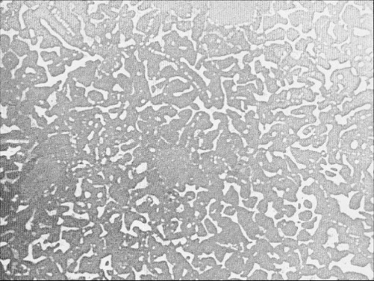
SNAP and U–ZrH Fuel
SNAP, 1955–1973: compact U–ZrH cores, NaK coolant, SiGe thermoelectrics
  six hydride reactors built and run, 50 kWt – 1 MWt
SNAP-10A, launched 3 April 1965 – still the only U.S. reactor flown
  37 U–ZrH rods; Be reflector on an explosive-bolt band
  ~590 We for 43 days; shut down by a spacecraft voltage regulator
Fuel and moderator in one material: U particles in a continuous ZrHₓ matrix
  SNAP: Zr–10 wt% U, 93% enriched, H/Zr 1.68–1.83, ~0.6 g U/cm³
  prompt negative temperature coefficient – the core self-regulates
The limit is hydrogen retention, not melting: ~850 °C peak fuel
(U₀.₃₁Zr)H₁.₆: black = U metal, gray = ZrH₁.₆ (45 wt% U LWR composition, not SNAP's 10 wt%). Olander, Konashi & Yamawaki, CNM 2nd ed., 5.08, Fig. 1
Notes:
Merged your SNAP Program and SNAP Fuel slides. Dropped from the slide: SNAP-8 ER details (600 kWt, 211 elements, 93.15% enriched, 6.56 kg U-235, 10,000 h; NaK 1100/1300 °F; BeO/Be reflectors). Sources: Johnson & Burns 5.21 (SNAP-10A rods, reflector band); Olander et al. 5.08 Table 1 (SNAP composition).

Slide 9
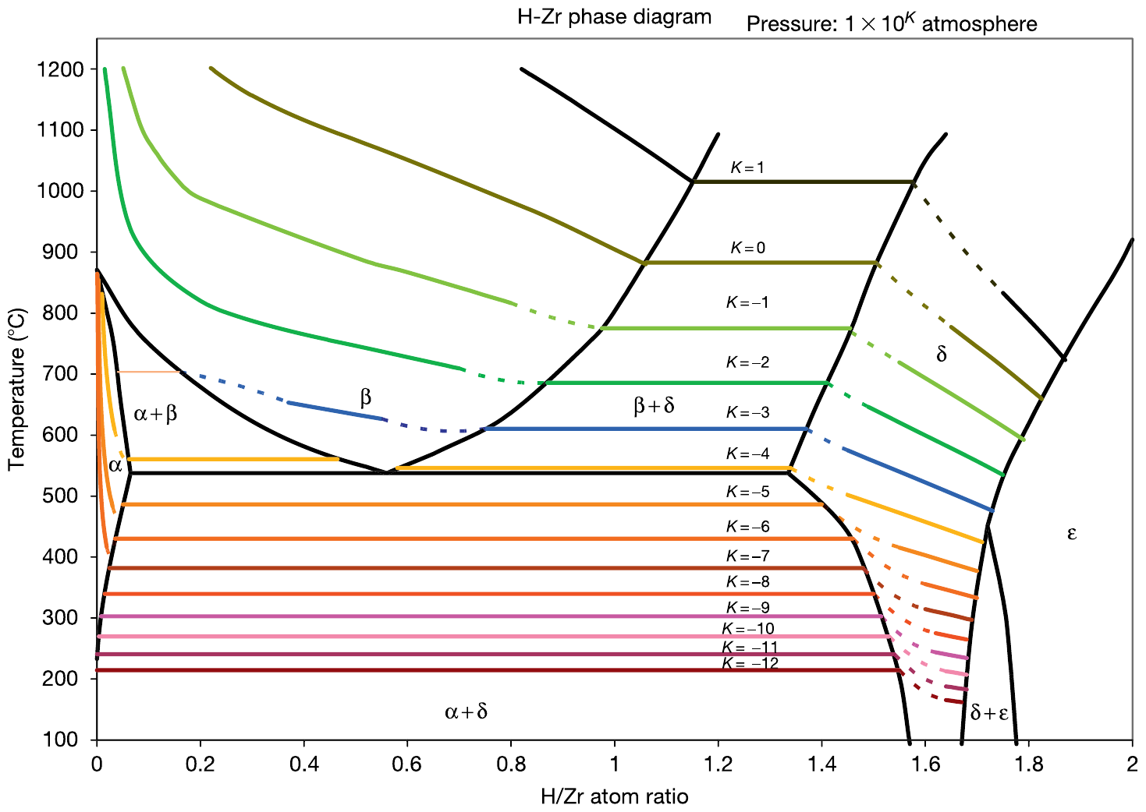
Keeping Hydrogen in the Fuel
Equilibrium H₂ pressure climbs steeply with T and H/Zr
  ZrH₁.₆ at 700 °C: ~0.1 atm; SNAP at 850 °C: ~3 atm
  no mechanical threat, but it drives permeation – the major SNAP constraint
H also migrates toward cooler regions, shifting local moderation
SNAP-8: Hastelloy-N cladding + ceramic barrier (AI-8763D)
  the barrier also carried the Sm₂O₃ burnable poison
  a crack is an unrecoverable leak you cannot inspect in orbit
Unprotected ZrH loses H fast
  1 cm pellet, 700 °C, breached clad: H/Zr 1.6 → 1.52 in 1 h
Same problem today for ZrH and YH moderators
H–Zr phase diagram with equilibrium H₂ isobars (10ᴷ atm). Olander, Konashi & Yamawaki, CNM 2nd ed., 5.08, Fig. 6
Notes:
Merged hydrogen pressure, redistribution, and permeation barrier content. Sources: Olander et al. 5.08 §5.08.1.2, §5.08.2.2–2.3, §5.08.4.4. Redistribution detail (for lecture): H/Zr 1.6 goes to ~1.46–1.49 at pellet center and ~1.74–1.78 at the rim (heat of transport Q*/R ≈ 640 K).

Slide 10
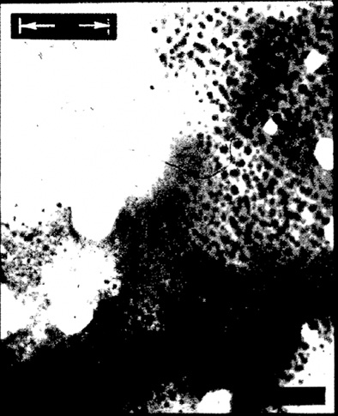
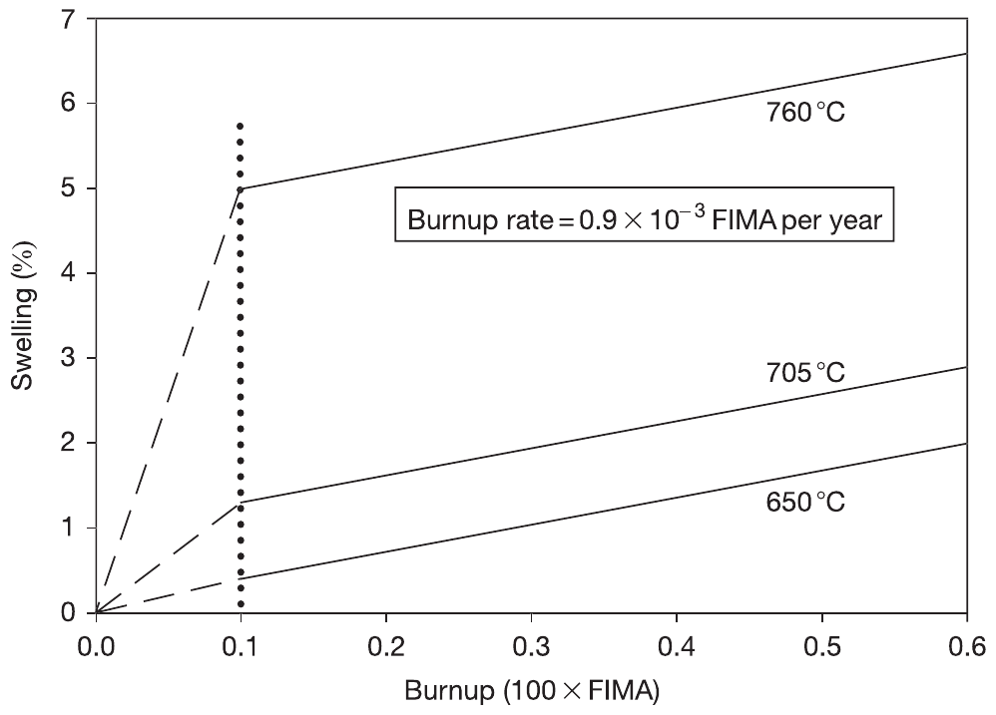
U–ZrH under Irradiation: the SNAP Data
"Offset" swelling: voids next to U particles, from fission-fragment damage
  ~10% locally, ~4% averaged over the cross section
  ~5% at 760 °C, vanishes near 650 °C
  assumed to saturate at ~10⁻³ FIMA – weakly supported by data
Then fission-product swelling at ~3% per %FIMA
  ~3× oxide on an equivalent-burnup basis
Fission gas: only recoil release (~10⁻⁴) below ~650–700 °C
  data are second-hand, with poorly known temperatures
Below ~650 °C swelling and gas release are small – SNAP peaked at ~850 °C
Left: voids near a U particle, SNAP fuel (TEM). Right: swelling vs. burnup at 650–760 °C. Olander, Konashi & Yamawaki, CNM 2nd ed., 5.08, Figs. 33, 34
Notes:
Source: Olander et al. 5.08 §5.08.3.2–3.4; original data Lillie et al., AI-AEC-13084 (1973).

Slide 11
SP-100 and UN Fuel
SP-100 (1983–1994): 100 kWe, 10 yr life, ≤3000 kg, sized for the Shuttle bay
  UN pins; PWC-11 (Nb–1Zr–0.1C) clad, vessel, piping; ⁶Li-depleted Li coolant
  outlet 1300–1350 K; SiGe/GaP thermoelectrics at ~4%, so a very large radiator
  12 BeO reflector segments for control; LiH / W shield
  cancelled without flight – a full core of UN was made, with low swelling
Why UN: ~13.5 g U/cm³, high conductivity that rises with T, high melting point
Why not: dissociates instead of melting congruently; wants N₂ overpressure at high T
  oxygen- and moisture-sensitive; ¹⁴N(n,p)¹⁴C argues for costly ¹⁵N
  swelling and fission gas set the pin design: plenum, smear density, gap
UN is also the reference fuel for JIMO, cermet NTP, and several microreactors
Notes:
Merged your SP-100 and UN Fuel slides; added requirements and results from Johnson & Burns 5.21. CHECK: your SP-100 slide said 4 in-core B4C safety rods; 5.21 describes 7 internal B4C rods with BeO followers. I left the rods off the slide. Possible figure: SP-100 core cross-section from NASA TM-101403 (in your sources).

Slide 12
Refractory Alloys and Alkali Metals
Refractory alloys
  Nb–1Zr, PWC-11, Mo–Re, Ta–10W, W–Re–Mo: the only options above ~1300 K
  Zr and Hf scavenge oxygen – the reason Nb–1Zr survives Li
  O pickup in fabrication is the dominant failure mode: Nb–1Zr is attacked above ~3375 ppm O
  recrystallization and irradiation hardening raise DBTT
  U.S. industrial capability has eroded since SP-100
Alkali metal compatibility
  pure alkali metals are compatible; impure ones are not
  O and C leave the condenser wall and concentrate at the evaporator
  targets: <0.1 ppm O in Na; Ti and Zr getters
  demonstrated: Mo/Na 45,039 h at 1391 K; Nb–1Zr/K 10,000 h at 1150 °C
  Mo/Li failed at 25,216 h, 1700 K (grain-boundary Ni attack)
  lifetime is set by cleanliness in manufacturing
Notes:
Merged your Refractory Alloys and Alkali Metal Compatibility slides; content is yours, shortened.

Slide 13
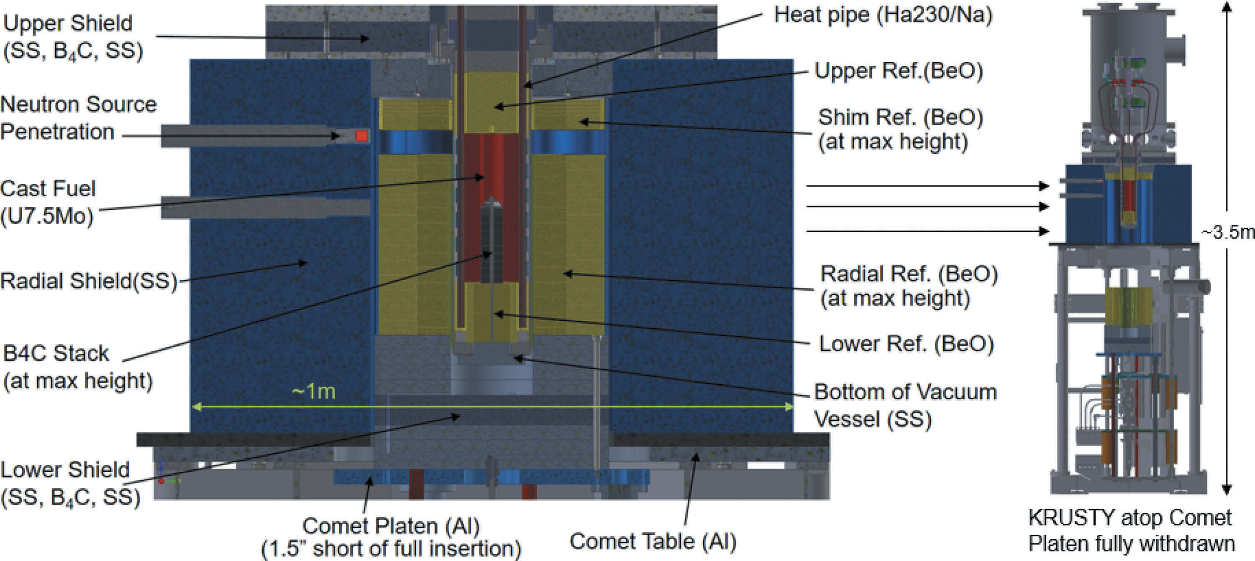
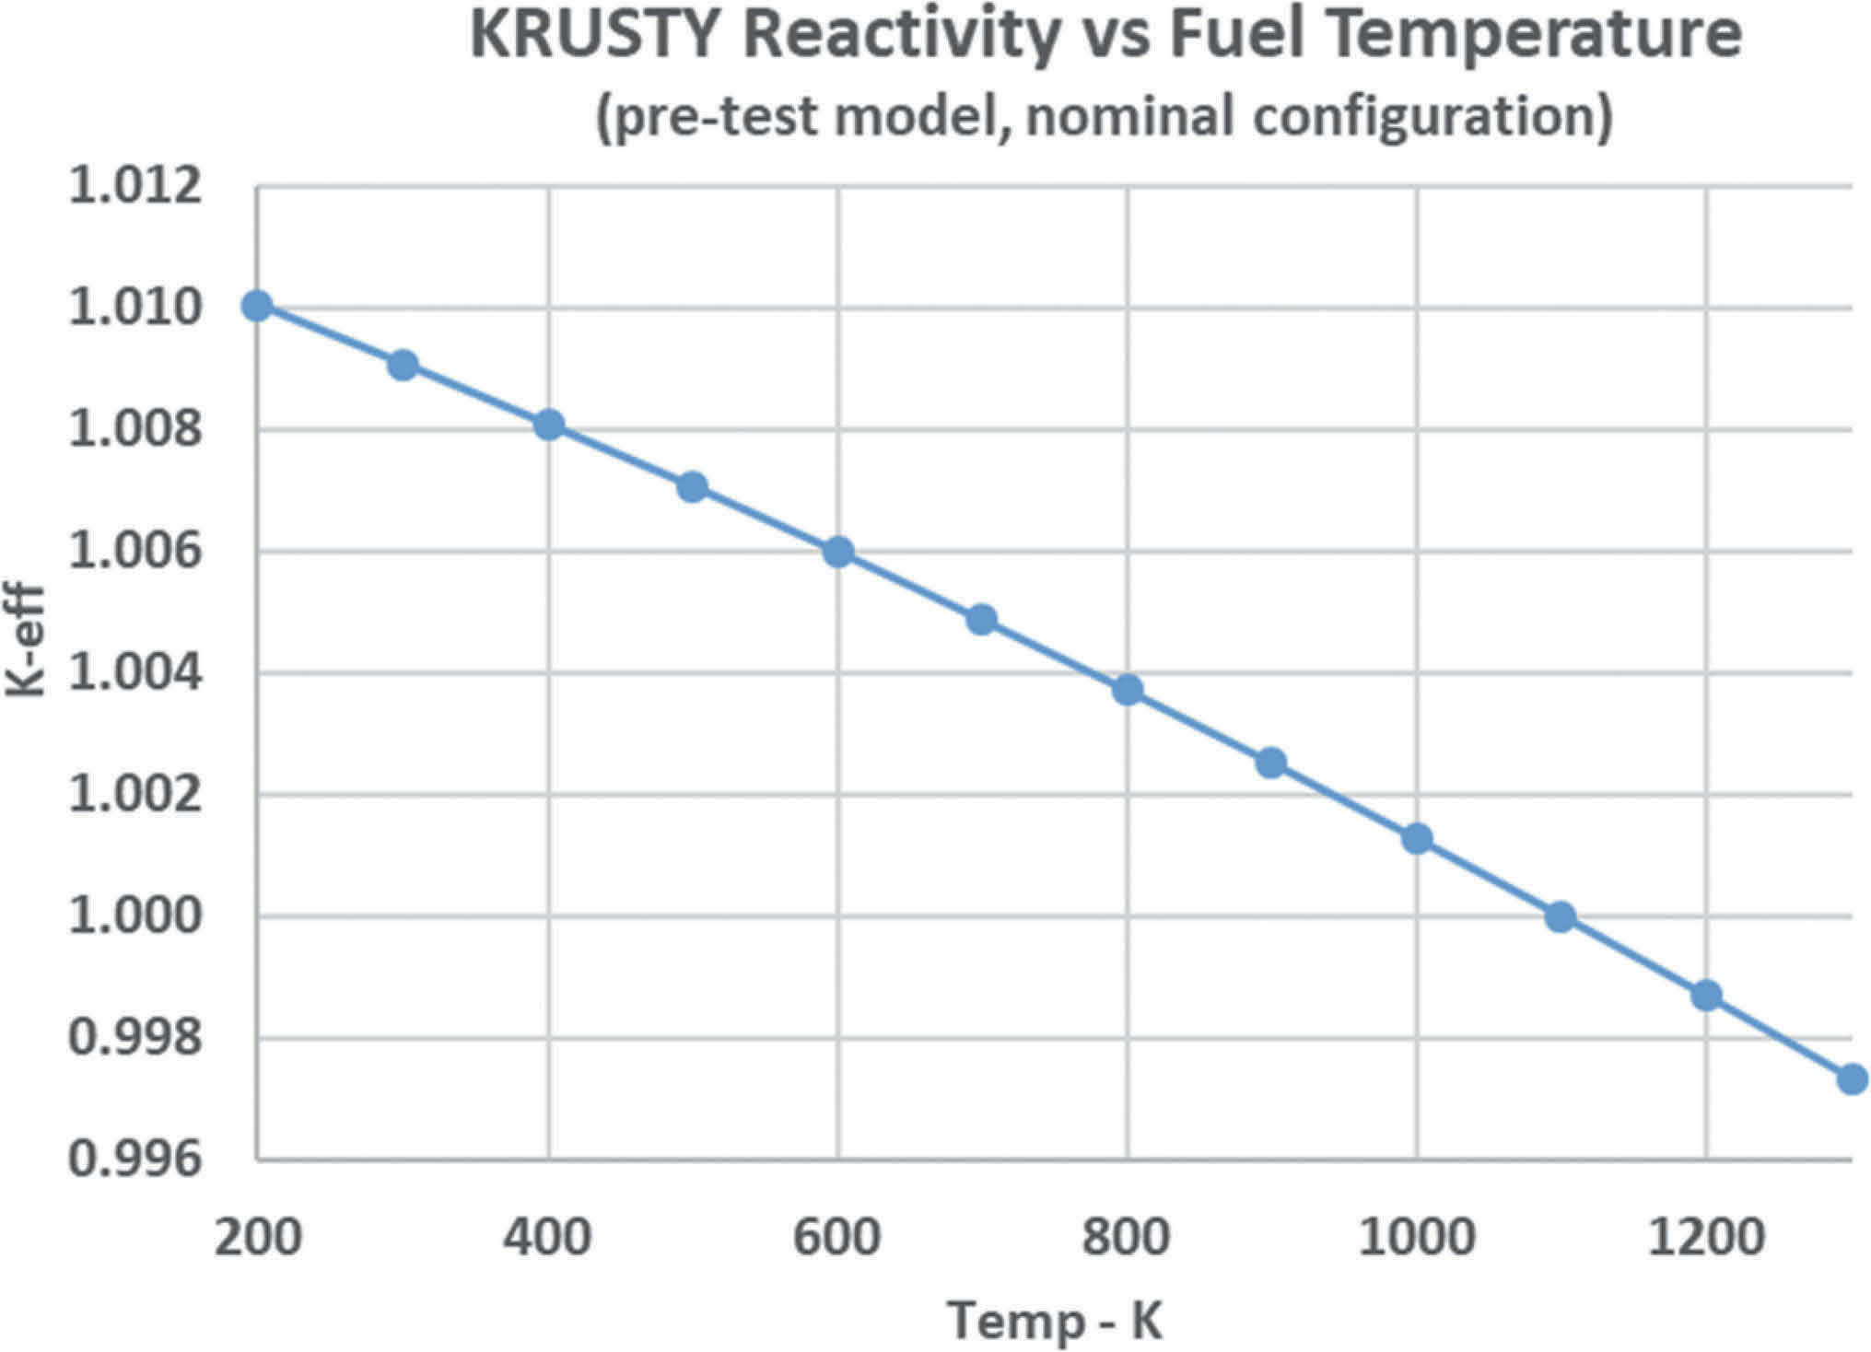
Kilopower and KRUSTY
Kilopower (LANL/NASA): 1–10 kWe for 12–15 years
KRUSTY: 5 kWt test at NNSS, Nov 2017 – Mar 2018
  cast HEU U–7.65Mo, 32.2 kg; 4 cm ID, 11 cm OD, 25 cm tall
  8 Haynes 230 / Na heat pipes clamped into the fuel
  BeO reflector; 2 Stirlings + 6 thermal simulators
28 h full-power run, fuel ~800–850 °C
  convertor shutdown, cycling, loss of heat removal – it self-regulated
Feedback is the fuel: ~95% of the net, ~90% of that from thermal expansion
  fuel coefficient ≈ –0.18 ¢/K
Top: KRUSTY on COMET. Bottom: calculated keff vs. fuel temperature. Poston et al., Nucl. Technol. 206 (2020), Figs. 2, 10
Notes:
Corrected from Poston et al. 2020: 15 g Na per heat pipe (not 15 cc); U–7.65Mo actual (nominal U–8Mo); 32.2 kg fuel. Feedback breakdown from §IX and Table II. Possible figure: KRUSTY loss-of-heat-removal test data in NASA Kilopower media-event charts (May 2018).

Slide 14
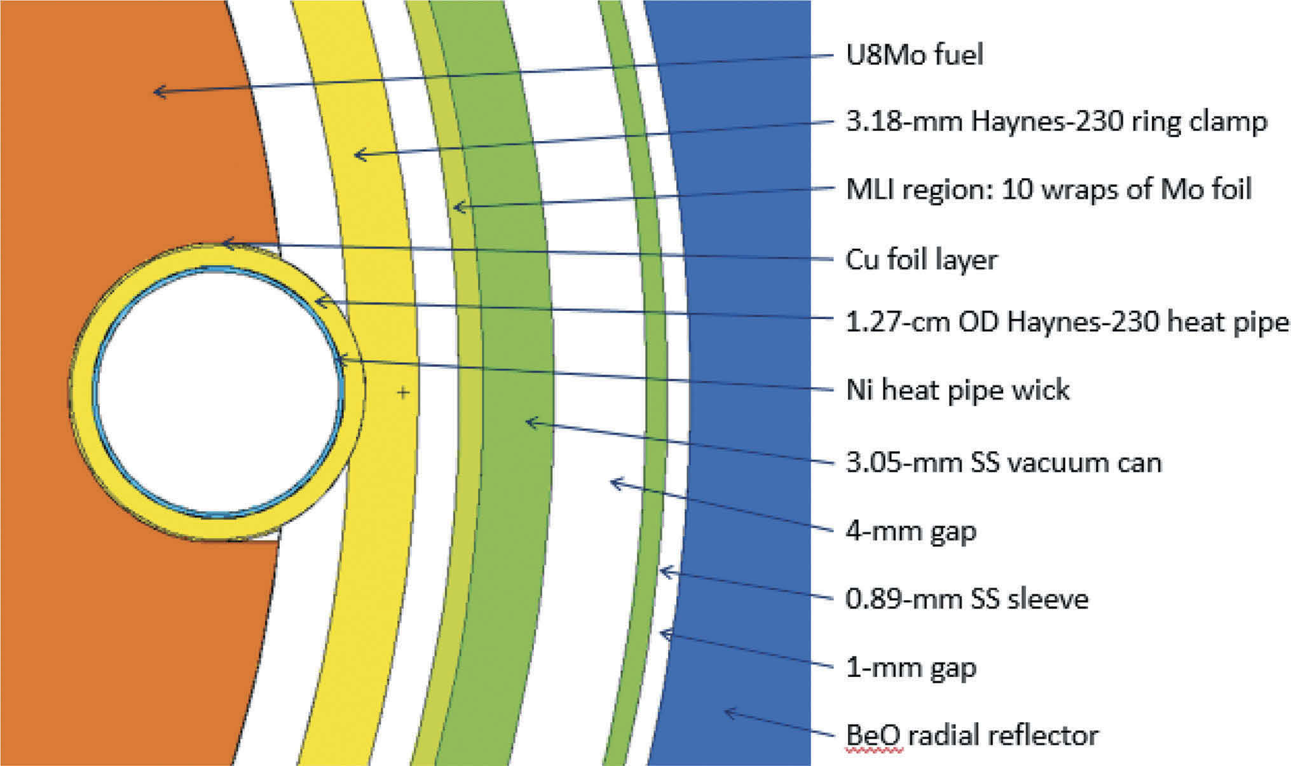
KRUSTY Fuel and Core Materials
Why UMo: the largest metallic-fuel experience base
  Mo stabilizes γ-U and suppresses α-U anisotropic growth
  Mo's epithermal capture helps keep a flooded core subcritical
Cast at Y-12 in three pieces: >99% TD, ~300 ppm C
Haynes 230 ring clamps shrink-fit the heat pipes to the fuel
  Cu foil between UMo and Haynes 230 blocks interdiffusion at 800 °C
Mo-foil MLI; B₄C shield plates delivered at ~75% TD
What 28 h does not tell you for 12 years:
  fission gas swelling; creep around the slots and gap conductance
  fuel / heat pipe interdiffusion; γ-U–Mo stability under irradiation
Outer core region (MCNP model). Poston et al., Nucl. Technol. 206 (2020), Fig. 4
Notes:
Merged your KRUSTY Fuel slide with new core-materials content from Poston et al. 2020 §VIII.

Slide 15
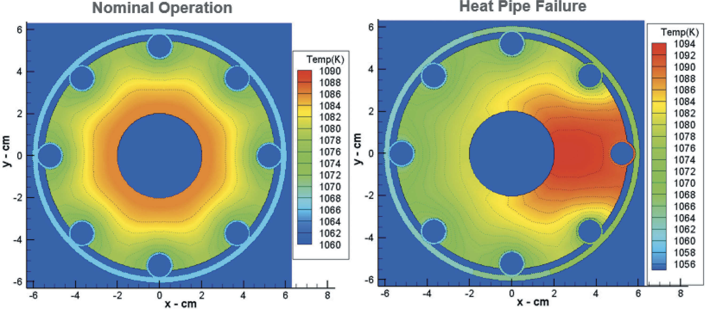
Heat Pipes
No pump, no moving parts – what you want when you cannot maintain it
Envelope + wick + working fluid; the fluid sets the range
  Na ~800–1100 K (Kilopower); K intermediate; Li 1400–1700 K (SP-100 class)
Envelope follows the fluid: Haynes 230 or SS for Na; Nb–1Zr or Mo for K, Li
Failure modes are chemical – the pipe fouls, it does not burst
Redundancy: lose a pipe and its neighbors carry the heat (right)
The fluid has reactivity worth too
  KRUSTY's Na pool re-formed when heat removal stopped, adding reactivity
  fix: 25 → 15 g Na, pipe bottom moved 7.6 cm below the core
Calculated core midplane temperature, nominal vs. one failed heat pipe (~1056–1094 K). Poston et al., Nucl. Technol. 206 (2020), Fig. 13
Notes:
Added from Poston et al. 2020: failed-heat-pipe map and the Na pool design change (§VIII.B).

Slide 16
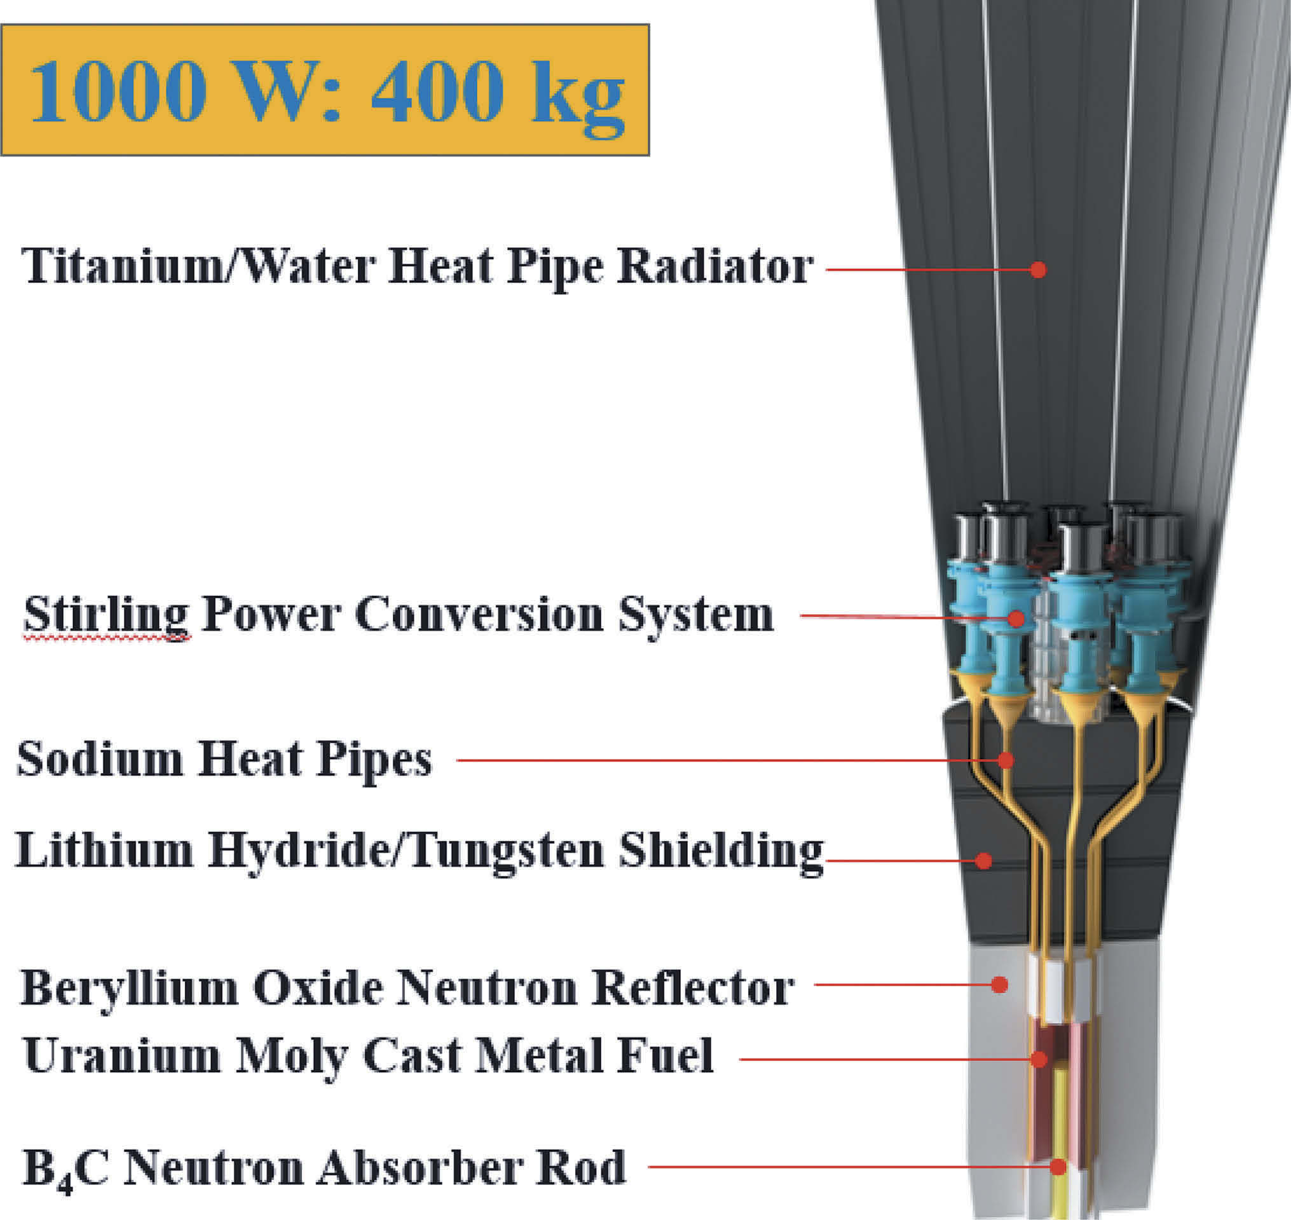
Power Conversion and Shielding
Conversion – efficiency buys radiator area, and radiator area is mass
  SiGe thermoelectric: no moving parts, ~4% (SNAP-10A, SP-100)
  Stirling: best tested ~30%; Kilopower 1 kWe = 8 × 125 W units
  closed Brayton: NASA's route at 100 kWe; turbine alloy limits outlet T
Shielding – shadow shield only; 4π is unaffordable
  LiH for neutrons (most H per unit mass); W or DU for gammas
  LiH: H retention and a low T limit – the hydride problem again
  KRUSTY used SS304 + B₄C; LiH was too costly and slow to procure
1 kWe Kilopower flight concept (~400 kg). Poston et al., Nucl. Technol. 206 (2020), Fig. 1
Notes:
Added from Johnson & Burns 5.21 (Stirling, Brayton) and Poston et al. 2020 (shield choice). Dropped from your slide: Stirling hot-end alloy and regenerator as the materials issues.

Slide 17
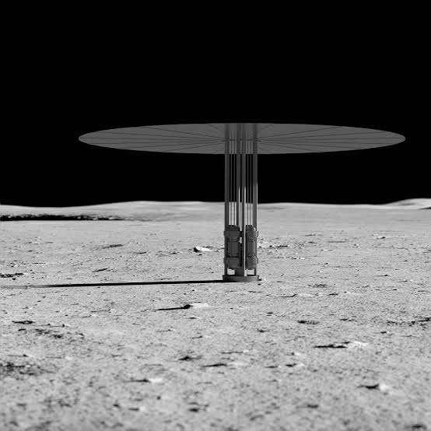
Fission Surface Power Today
Phase 1 (2022): three 12-month design contracts at 40 kWe
  Lockheed Martin, Westinghouse, IX (Intuitive Machines / X-energy)
  6000 kg limit, 120 Vdc, 5 rem/yr at 1 km
August 2025 RFI: 100 kWe with closed Brayton conversion
  heavy-class lander, up to 15 t
January 2026: NASA/DOE MOU; reactor ready by Q1 FY2030
  "built by then" vs. "operating on the Moon by then" is left ambiguous
Russia and China: lunar reactors announced for 2033–2035
Fuel form and enrichment are not public for all three U.S. teams
Notes:
Text yours, shortened to fit the figure.

Slide 18
Nuclear thermal propulsion

Slide 19
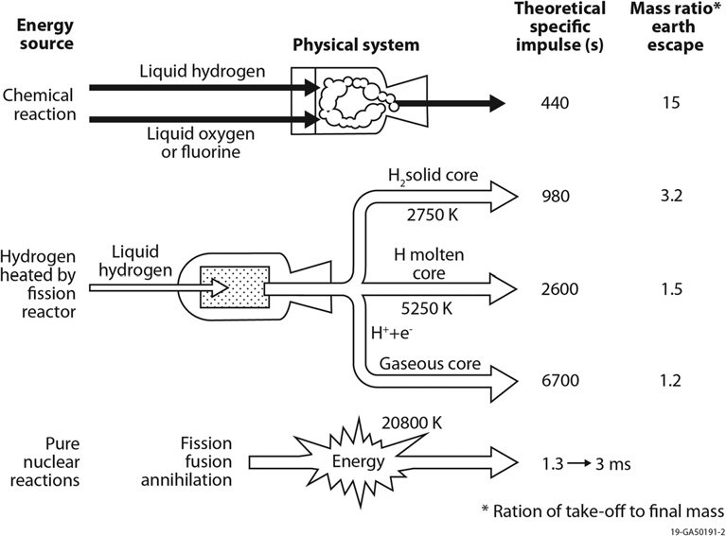
NTP: Why Hydrogen, and Why It Hurts
H₂ flows through a fueled solid and out a nozzle: Isp ∝ √(T_c / M)
  LH₂/LOX exhausts M ≈ 18–22; NTP exhausts pure H₂, M = 2
  roughly doubles Isp; peak T is set by the fuel, not chemistry
Hydrogen is the best propellant and the worst environment
  reduces oxides – UO₂ survives only if encapsulated
  carbon → CH₄ / C₂H₂ (~1500–2900 K); U–Zr–C vaporizes above ~2900 K
  atomic H permeates metals and strips hydride moderators
  flow sweeps products away – no protective scale, attack never self-limits
How hot can a fueled solid get in flowing H₂ without losing its uranium?
Theoretical Isp and mass ratio by propulsion type. Johnson & Burns, CNM 2nd ed., 5.21, Fig. 1
Notes:
Merged NTP Fundamentals and Why Hydrogen, and Why It Hurts. Full Isp expression from your slide: Isp ≈ (1/g0)√[2γ/(γ–1) · RuTc/M]. I did not use 5.21's "Isp = 9.54√Te" (gives ~500 s at 2700 K, so likely a typo).

Slide 20
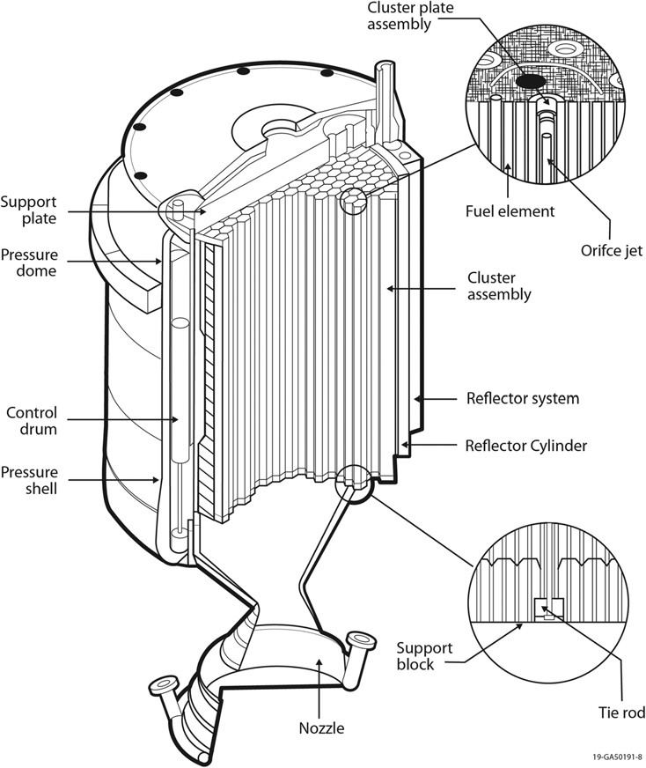
Rover/NERVA Overview
1955–1973: 13 research reactors + 6 engines tested in Nevada
  Kiwi (1959–64): proved the concept, found the failure modes
  Phoebus (1965–68): Phoebus-2A reached 4082 MWt
  Pewee (1968): ZrH-moderated; temperature and power-density records
  NRX / XE (1964–69): NRX-A6 62 min continuous; XE′ 28 restarts
  NF-1 (1972): fuel test bed, ~109 min at full power
USSR: ~1550 fuel assemblies, 7 core tests – little post-irradiation exam
Missing from both: long-duration, high-burnup fuel data
Cancelled 1973 for budget and mission, not technical failure
KIWI-B4A engine cutaway. Johnson & Burns, CNM 2nd ed., 5.21, Fig. 8
Notes:
Merged Rover/NERVA Overview with What Rover/NERVA Actually Demonstrated. Dropped from the slide: Pewee 2750 K fuel / ~2550 K exhaust / ~5200 MW/m³; Soviet 2800–3300 K exit, 0.5–1.0% U loss, ~160 IGR transients. CHECK vs. 5.21: Phoebus-2A 4082 MW (you had 4100); Soviet max exit 3100 K; 5.21 lists >90 min continuous and 3311 K max exhaust for the program; Pewee 2539 K exit, 2340 MW/m³ average.

Slide 21
Rover/NERVA: What Each Test Taught
Test | Fuel / coating | What happened → lesson
KIWI-A (1959) | Uncoated UO₂ in graphite plates | 70 MW, 5 min; closure plate shattered, supports corroded → graphite needs protection from H₂
KIWI-A′ (1960) | NbC-coated UO₂ particles; NbC channels | 88 MW; three modules ejected by corrosion → coatings alone are not enough
KIWI-B4A (1962) | Hex 19-channel elements, NbC liners | 97% of elements failed – flow-induced vibration, not materials → fixed by cold-flow testing
KIWI-B4E (1964) | PyC-coated UC₂ beads | 937 MW, 8 min at full power; UC₂ reverted to oxide and swelled in air → 50–150 µm beads, 25 µm PyC
Phoebus-1B (1967) | NbC + Mo overcoat | Thinner NbC (many small cracks) beat thicker; external coating cut loss 2 → 0.7 g/element; ~1.5% FP release
Pewee (1968) | NbC vs. ZrC, both Mo-overcoated | ZrC-coated elements lost only 50–75% as much mass
NF-1 (1972) | (U,Zr)C–graphite composite; (U,Zr)C carbide | Composite: better corrosion, but fission damage cut conductivity → cracking. Carbide: cracked midband, not into particles
Johnson & Burns, CNM 2nd ed., 5.21, §5.21.3
Notes:
New slide. All entries from Johnson & Burns 5.21 §5.21.3.

Slide 22
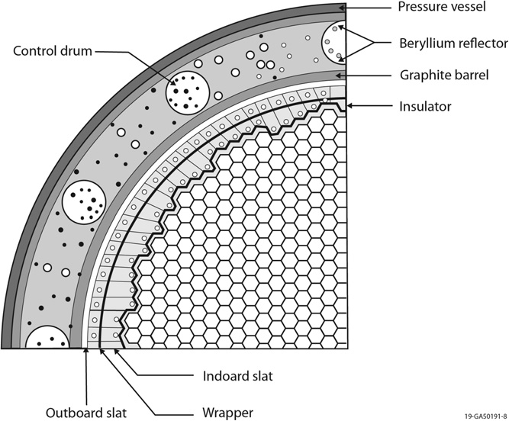
NERVA Core and Fuel Elements
Hex fuel elements around structural tie tubes
  SNRE: 564 elements, 241 tie tubes; pressure drop holds the core in compression
Be reflector with B₄C-faced control drums
H₂ cools nozzle, reflector, and tie tubes before the core – structure stays cold
Element: ~0.75 in across flats, 0.89–1.32 m long, 19 channels of ~2.5–2.8 mm
Channels CVD-coated, NbC then ZrC
  ~100 µm ZrC; furnace ramped ~1400 → 1700 K along the element to offset reactant depletion
~0.25–0.60 g U/cm³; peak ~5 MWt/L (LWR: ~0.1 MWt/L)
Quarter cross-section of a typical Rover/NERVA core. Johnson & Burns, CNM 2nd ed., 5.21, Fig. 9
Notes:
Merged The NERVA Core and Fuel Element Geometry. Coating process details from Johnson & Burns 5.21 §5.21.7.5. Possible figure: NERVA element photo in Lyon, LA-5398-MS (1973), OSTI 4419566.

Slide 23
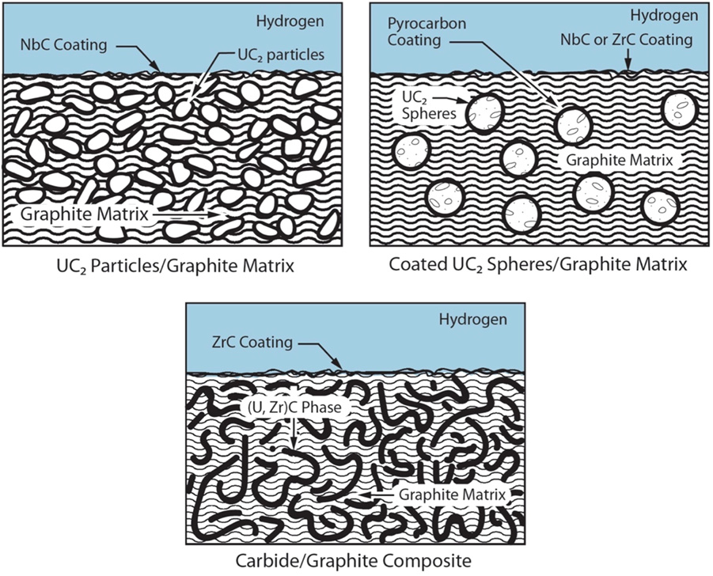
Graphite-Based Fuels: Beaded to Composite
Beaded: UO₂ / UC₂ particles in extruded graphite, later PyC-coated
  graphite moderates, machines well, is strong hot
  but hot H₂ makes CH₄ / C₂H₂, and matrix CTE ≠ coating CTE → coating cracks on heatup
Composite: continuous (U,Zr)C network in continuous graphite
  carbide holds the U and resists H₂; graphite gives conductivity and moderation
  CTE 6–6.5 vs. 7.1 μm/m·K for NbC → less cracking, less corrosion
NF-1 (1972): composite had the best corrosion resistance
  but fission damage to the graphite cut conductivity → matrix cracking
U loss shows up twice: as reactivity loss and as effluent contamination
Beaded (top) and composite (bottom) fuel. Johnson & Burns, CNM 2nd ed., 5.21, Fig. 3
Notes:
Merged Fuel Generation 1 and 2. NF-1 radiation damage finding from 5.21 (also Lyon, LA-5398-MS).

Slide 24
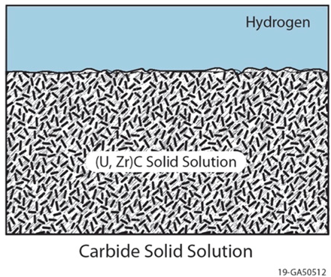
Fuel Generation 3: Carbides
Solid-solution (U,Zr)C, no free graphite – highest T capability tested
Composition control is the whole game
  substoichiometric carbon (C/M ~0.85–0.95) maximizes melting point; free C leached out with H₂
  ternary (U,Zr,Nb)C melts ~100–700 K above binaries with a separate C phase
Designed for 3200 K exit gas for 1–2 h
  NF-1 elements cracked heavily at midband, but not into the particles
USSR took this path: (U,Zr)C below 2500 K gas, (U,Zr,Nb)C to 3100 K, as twisted ribbons
Brittle, poor thermal shock resistance, hard to form; never qualified before 1973
Carbide solid solution. Johnson & Burns, CNM 2nd ed., 5.21, Fig. 3
Notes:
C/M range merged: yours 0.88–0.95; 5.21 gives 0.85–0.93 for NF-1 carbide elements.

Slide 25
Hydrogen Corrosion Mechanisms
Chemical attack, ~1500–2900 K
  carbon constituents react with H2 to form CH₄ and C₂H₂
  rate set by H2 partial pressure, temperature, and exposed carbon area
  dominant loss mechanism over most of the element length
  no protective product forms – flow sweeps everything away
Vaporization, above ~2900 K
  vaporization of U–Zr–C takes over
  shifts in the U/Zr/C ratio liberate free carbon, which then reacts chemically
Irradiation makes both worse
  radiation damage lowers thermal conductivity
  steeper gradients → higher stresses → more cracks → deeper hydrogen penetration

Slide 26
Coatings and Midband Corrosion
The coating is the only barrier between hot H₂ and the fuel
NbC first; cracked on heatup from CTE mismatch
  Mo overcoats (CTE ≈ fuel) and thinner NbC cut failures
ZrC later: better FP retention; Pewee ZrC elements lost 50–75% as much
Corrosion peaked midband, where power density was highest
  coating still brittle but gas already hot – cracks open and stay open
  about half the C loss was midband, half diffusional loss at the hot end
Failure is self-accelerating: crack → cavity → more coating unloaded
Coating integrity, not fuel melting, sets the practical limit
FIGURE GAP
Axial mass-loss / corrosion profile along a Rover/NERVA element, showing the midband peak.
Possible source: Lyon, LA-5398-MS (1973), OSTI 4419566; or the IntechOpen NTP materials review (2020) in your sources.
Notes:
Merged Coatings and Midband Corrosion. CHANGED: your midband slide said the fix was the fuel, not the coating; 5.21 also credits Mo overcoats and thinner NbC. CHECK: 5.21 says ZrC has a larger CTE mismatch than NbC and reinforced midband corrosion; your coatings slide said ZrC was a better match to composite fuel. Dropped that claim pending your call.

Slide 27
CERMETs: GE-710 and ANL (1962–68)
Idea: UO₂ in a W or Mo matrix – no carbon, no methane path, high conductivity. Cost: W is 19.3 g/cm³ and needs enriched ¹⁸⁴W.
Observed failure | Cause
O loss from UO₂ → free U, clad penetration on cycling | High-T reduction; Ta and Ta alloys transparent to oxygen
W–UO₂ swelling and cracking after cycling | W / UO₂ CTE mismatch pulls particles off the matrix
FP damage / release after 4000–7500 h at 1870–2270 K | Dense (≥95% TD) fuel left no room for fission products
Mo and other low-melting metals vaporized from the clad | Vapor pressure above ~2470 K
What worked: sintering to only 84–90% TD gave ~10× the burnup capability
Best results: W–25Re-clad W–UO₂ survived flowing H₂ at 3070 K for 10 h; ANL samples ramped to 2873 K at >10,000 K/s in TREAT without visible damage
For today's Mo–30W: HTMP judged Mo a poor alloying choice because of its vapor pressure above ~2470 K
Johnson & Burns, CNM 2nd ed., 5.21, §5.21.7.1–5.21.7.2
Notes:
Merged your CERMET History slide with the GE-710/ANL lessons. Dropped from the slide: 1–2 µm W powder sintered to ~95% TD; ANL gadolinia-stabilized fuel retained UO2 at 2770 K for 45 h and 180 cycles.

Slide 28
CERMETs Today: UN in Mo–30W
NASA reference: UN particles at 40–70 vol% in a Mo–30W matrix
  UN: more U, higher conductivity and melting point than UO₂
  Mo–30W: lighter and less absorbing than W; resists grain growth far better than Mo
  coated particles (e.g., W) block UN–matrix interaction and fission product release
Made by HIP or spark plasma sintering
  SPS: Mo to 96–98% TD at 1573–1773 K in <3 min, with little grain growth
  more fuel = more U but a weaker, less connected matrix
  ceramic particles suppress matrix grain growth (YSZ surrogates in Mo–30W)
Open issues
  UN dissociates and needs N₂ overpressure – impossible in a H₂ channel
  reproducibility at element scale, not feasibility
Notes:
Merged CERMET Current Reference and CERMET Fabrication. SPS numbers from Johnson & Burns 5.21 §5.21.7.3. Dropped: Gd2O3/Y2O3 stabilizer bullet.

Slide 29
Hot Hydrogen Testing
Mo–30W + YSZ surrogate particles, flowing H₂, 1920–2500 °C, 80 min
  minimal mass loss, little cracking, good particle retention
  the solid solution beat pure Mo, especially at the top of the range
Real UN is starting to appear
  W-coated UN kernels in Mo30W, 1800–2300 °C (Cröll et al. 2025)
  pores at 2000 °C traced to residual oxides + H forming water vapor
What these tests are not
  no fission: no fission products, no gas, no radiation damage
  minutes to hours, not a mission duty cycle
No modern integral irradiation data on any candidate NTP fuel
FIGURE GAP
Before/after hot-hydrogen micrographs of a Mo30W cermet (surrogate or UN).
Possible source: Cröll et al., Nucl. Sci. Eng. 199 (2025), OSTI 2340868; or your J. Nucl. Mater. (2024) Mo30W surrogate paper.
Notes:
Added Cröll et al., Nucl. Sci. Eng. 199:82–99 (2025), doi 10.1080/00295639.2024.2332001 (web search; not in the attached chapters).

Slide 30
Moderators: Tie Tubes, ZrH, and YH
A HALEU core needs moderation – hydrogen inside a very hot core
NERVA-type cores carry it in the tie tubes
  ZrH sleeve + Inconel tubes; H₂ cools them, then returns to the core inlet
  Pewee: ZrH sleeves cut critical mass to 36.4 kg U
ZrH loses H rapidly above ~800 °C – it must stay far colder than the fuel
YH holds more H hot: ~1.6× ZrH at 900 °C, ~2.6× at 1100 °C
Both need cladding and a permeation barrier – H loss is reactivity loss
Data gaps: mechanics above 700 °C, irradiation past ~2 dpa, desorption kinetics
FIGURE GAP
Equilibrium H₂ pressure (or PCT curves) for δ-YH vs. δ-ZrH vs. temperature.
Possible source: Advanced Moderator Material Handbook (DOE Microreactor Program), OSTI 1921985 and OSTI 2999897; Kohnert, 2026 MRP Review (gain.inl.gov).
Notes:
Merged Tie Tubes and Moderators for NTP. CHANGED: your slides said ZrH loses H above ~700 K; 5.08 puts significant H2 pressure above ~800 °C and 5.21 says ~1070 K. Pewee details from 5.21. Possible tie-tube figure: Borowski & Sefcik, NTRS 20160014802 (check).

Slide 31
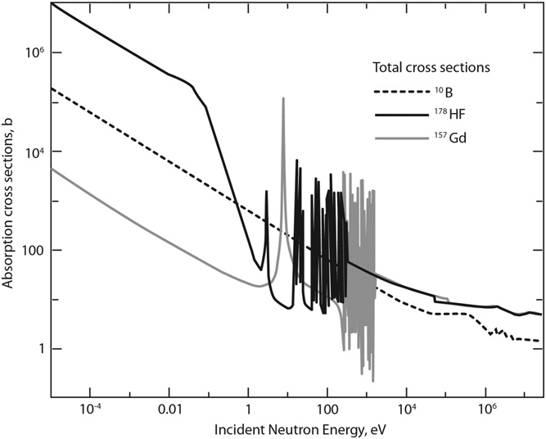
Reflectors, Control, and Structure
Radial reflector: Be or BeO – best reflection per unit mass
  limited to below ~1000 K; brittle; toxic dust
  fast n: (n,α) He and (n,2n) tritium → swelling at high fluence
Control drums: absorber on one face, rotated to change leakage
  B₄C (n,α) He swelling – minor at space-reactor fluxes
  Hf: epithermal resonances, HfC melts high; Gd only as burnable poison
Vessel at 3–8 MPa: Al lightest below ~490 K; else SS or Haynes 230
  minimize Co – ⁶⁰Co gammas cost shield mass
Hot-end cladding: Ta, Ta–10W, W–30Re–30Mo
Absorption cross sections: ¹⁰B, ¹⁷⁸Hf, ¹⁵⁷Gd. Johnson & Burns, CNM 2nd ed., 5.21, Fig. 10 (from Emrich 2016)
Notes:
Added from Johnson & Burns 5.21 §5.21.6. Dropped: tie tube bullet (now on the moderator slide).

Slide 32
HALEU, and DRACO
Rover/NERVA was HEU; modern programs must stay below 20%
  less ²³⁵U → more moderation or a bigger core → hydride in the core, and more mass
  more ²³⁸U → more parasitic absorption
The historical fuel, corrosion, and coating database is all HEU
DRACO (DARPA, NASA joined 2023): HALEU in-space NTP demonstration
  Lockheed Martin + BWXT selected July 2023; launch planned 2027, Isp >800 s
  cancelled 30 May 2025 – falling launch costs, not a materials or test failure
Discussion: could an unqualified fuel have met that schedule regardless?
Notes:
Merged From HEU to HALEU and DRACO. Dropped: BWXT HALEU processing and General Atomics early design work.

Slide 33
What Is Actually Blocking Deployment
None of these are new materials – the same 1960s list, still not qualified
No qualified NTP fuel: no irradiated, hot-hydrogen-tested basis for cermet or carbide
No integral test: fueled elements, flowing H₂, temperature, and fission at once
Irradiation: fast spectrum, almost no relevant data; YH stops near ~2 dpa
Properties above 2000 K for (U,Zr)C, UN, Mo–W: sparse, often one 1960s study
Fabrication: refractory alloys, carbides, cermets are hard to make reproducibly
Power systems: alkali purity and a decade of unattended life are unproven
No validated fuel performance code for NTP conditions
Notes:
Merged Cross-Cutting Materials Challenges and NTP Materials Gaps.

Slide 34
Summary
Space nuclear is two materials problems, not one
  NTP: hot, short, hydrogen. Power: warm, long, liquid metal
NTP fuel evolved beaded graphite → composite → carbide → cermet; none of them is qualified
Hydrogen corrosion, CTE-driven coating cracking, and midband corrosion are the classic NTP failure modes
HALEU pushes moderator into the core, which makes hydride hydrogen retention a first-order problem
Power systems are limited by refractory alloy fabrication, alkali metal purity, and unattended lifetime
KRUSTY showed that a complete system works. It did not show that it works for twelve years
The gap between “demonstrated” and “qualified” is the entire remaining program

Slide 35
Sources
Nuclear thermal propulsion
Nuclear Thermal Propulsion Reactor Materials, IntechOpen (2020)
  fuel forms, coatings, hydrogen corrosion, and the Rover/NERVA and Soviet test records
Space Nuclear Propulsion for Human Mars Exploration, National Academies (2021)
Borowski & Sefcik, NTP engine and fuel element design, NASA NTRS 20160014802
Hot hydrogen testing of Mo30W matrix surrogate cermets, J. Nucl. Mater. (2024)
Yttrium hydride neutron moderators in microreactors, review (2026)
DRACO program timeline and cancellation – secondary summary
Johnson & Burns, Space Reactor Technology Development, Comprehensive Nuclear Materials 2nd ed., 5.21 (2020)
Cröll et al., Hot Hydrogen Testing of W-Coated UN Kernels in a Mo30W Matrix, Nucl. Sci. Eng. 199 (2025)
Space fission power
Poston et al., KRUSTY Reactor Design, Nuclear Technology 206 (2020)
KRUSTY design detail, LANL LA-UR-15-26603 (OSTI)
Kilopower program summary and KRUSTY test results – secondary summary
SNAP-8 Experimental Reactor description, INL Virtual Test Bed
SNAP-10A flight summary – secondary summary
SP-100 Nuclear Space Power Systems, NASA TM-101403 (1988)
Alkali Metal Heat Pipe Life Issues, NASA NTRS 20040082321
NASA Fission Surface Power, Phase 1 project documentation (NTRS, 2022)
NASA/DOE lunar surface reactor announcement (January 2026)
Olander, Konashi & Yamawaki, Uranium–Zirconium Hydride Fuel, Comprehensive Nuclear Materials 2nd ed., 5.08
Notes:
Merged the two source slides. The note "Rover/NERVA test data quoted here trace to the two reviews above, not to the original test reports" moved here: Rover/NERVA data trace to the reviews and Johnson & Burns, not original test reports.

